Slide 1
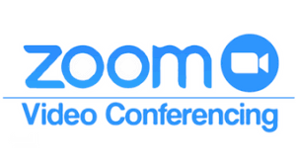
Welcome to
CSC 205 - Application Development in C#
Wed/Fri 3:00 PM - 5:30 PM, May 10 – July 3
online via (ID: 421 165 2333)
https://zoom.us/j/4211652333

Slide 2
Contact Information
Name: Dr. Guangyan Li
Telephone: (206) 880-3129 (Cell), (360) 688-2749 (Office)
Email: gli@stmartin.edu
Office Hours: 1:00 PM – 3:00 PM W/F; other time available by appointment! Zoom (https://zoom.us/j/4211652333)
Communication: phone or email (preferred)

Slide 3
Course Description
An introduction to programming cloud applications in C# including a coverage of the Visual Studio development environment. Key topics including C# syntax, variables, types, expressions, classes, and interfaces are introduced leading to a final application project.

Slide 4
Course Objectives
By the conclusion of this course, each student should be able to:
Develop low to medium complexity C# programs using the Microsoft Visual Studio integrated development environment (IDE).
The concept of C# and its relationship to the Microsoft .NET Common Language Runtime (CLR)
C# syntax: identifiers, keywords, operators, statements, types, storage, and variables.
Flow control: method invocation, parameters, arrays, looping, overloading.
Create methods, handle exceptions, and describe the monitoring requirements of large-scale applications.
Understand OOP (Object-Oriented Programming) concepts, create classes, define & implement interfaces, etc.

Slide 5
Textbooks and Additional Readings
Think Sharp - How to Think Like a Computer Scientist, Allen B. Downey & Peter J. Knaggs (5.1.2 / 0.3) ßmain!
http://tiny.cc/3qdxtz
Think Sharply with C# or How to Think Like a Computer Scientist, by Peter Wentworth
http://www.ict.ru.ac.za/Resources/ThinkSharply/ThinkSharply/index.html
C Sharp Programming, Wikibooks.org
https://en.wikibooks.org/wiki/C_Sharp_Programming
Microsoft official documentation:
https://docs.microsoft.com/en-us/dotnet/csharp/
C# 9.0 in a Nutshell: The Definitive Reference 1st Edition by Joseph Albahari, O'Reilly Media; 1st edition (March 2021) ISBN-13: 978-1098100964 (not required)

Slide 6
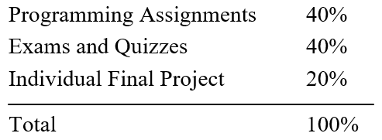
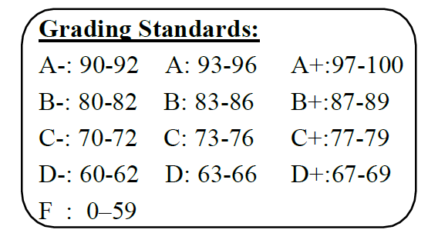
Assessment Methods

Slide 7
Learning Objectives
Getting Started
Quick review of the Syllabus, Moodle, Zoom
Comprehend introductory concepts related to computers and programs
Comprehend the use of IDE (focus on Visual Studio), the process of compiling a C# program
Comprehend the build-in types in C# and when to use them
Implement various C# programs that implement the concepts covered in this module
Variables and Expressions
Comprehend basic C# syntax, the purpose and use of variables, and how to use expressions
Describe the generally accepted naming conventions for C#
Comprehend how to use console input and output
Implement various C# programs that implement the concepts covered in this module
Flow Control
Comprehend Boolean logic, if statement, switch statement, do loop, while loop, for loop
Comprehend how to generate random numbers
Comprehend how to use basic file input and output
Implement various C# programs that implement the concepts covered in this module

Slide 8
Learning Objectives – cont’d
More about Variables, Arrays, Exception Handling, Namespaces, and Enumerations
Comprehend 1d-arrays, string, type conversion
Comprehend basic exception handling, how to define enumeration types, and namespaces
Implement various C# programs that implement the concepts covered in this module
Methods
Comprehend methods, return values and parameters, variable scope, how to call a method
Understand recursion
Implement various C# programs that implement the concepts covered in this module
Defining Classes and Class Members
Comprehend classes, class members, access modifiers, static members, constructors, and the this keyword
Implement various C# programs that implement the concepts covered in this module
Interfaces, Inheritance, and Polymorphism
Comprehend interfaces, inheritance, and polymorphism
Implement various C# programs that implement the concepts covered in this module

Slide 9
Attendance and More
You are expected to attend each class meeting. I found it is the best way to engage you in learning the course materials.
Students absent from an announced quiz or examination, unless excused, may not be permitted to make up quizzes or examinations.
You are expected to keep the instructor informed of any changes or issues that may prevent you from completing your assignments or this course.
You’re strongly encouraged to take advantage of my office hours. I’m available other times but you need email/call me in advance.
You are expected to check your SMU email at least once a day. This will be the way I will try to reach you.

Slide 10
How to Get Started with Moodle
Visit: http://moodle.stmartin.edu
See “Getting Started with Moodle,” “Tutorials for Students,” and “Frequently Asked Questions” in the pane entitled “NAVIGATION” in the left margin.
LOGIN with your Saint Martin’s username and password when ready. For username and password help, see: https://www.stmartin.edu/directory/integrated-technology-services/technology-help

Slide 11
Standard St. Martin's information
Helpful Links
Link to Saint Martin’s undergraduate Academic Catalog 2020-2021
https://www.stmartin.edu/sites/default/files/smu-files/registrar/2020-21-undergraduate-academic-catalog.pdf
Link to Student Handbook currently in use (2020-2021):
https://www.stmartin.edu/sites/default/files/smu-files/student-affairs/2020-21-8-24-saint-martins-student-handbook.pdf
Link to emergency/weather information:
http://www.stmartin.edu/directory/office-public-safety
Link to sign up for e2campus emergency alert text messaging:
https://www.e2campus.net/my/stmartin/signup.htm
Link to Office of Registrar forms:
http://www.stmartin.edu/forms?topic=Registrar

Slide 12
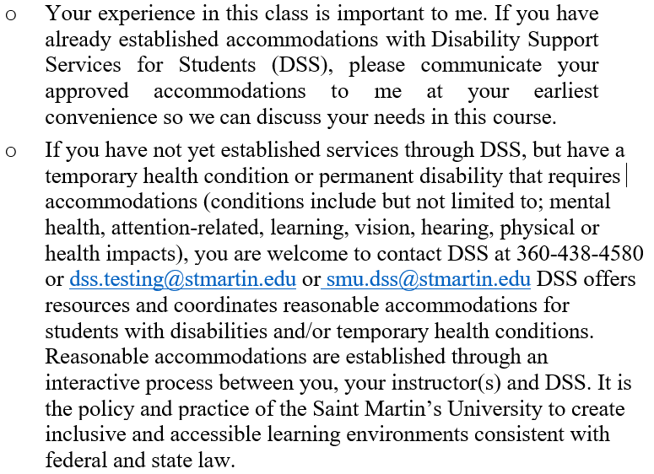
Access and Accommodations

Slide 13

Academic Honesty/Professionalism

Slide 14

Counselling and Wellness Center

Slide 15

Sexual Misconduct/Sexual Harassment Reporting

Slide 16
Syllabus Updates and Moodle Listings
The dates, schedule, requirements etc. are tentative
The instructor reserves the right to make changes to the syllabus during the duration of the course
Students will be informed, in advance, of any changes and an updated syllabus will be distributed and posted to Moodle
Students are responsible for checking Moodle and completing any requirements posted there

Slide 17
What is a programming language?
A programming language is a formal language comprising a set of instructions for computers to perform various kinds of operations
Computers can only run programs written in low-level languages (examples: machine language, assembly language)
There are thousands of so-called high-level languages such as C/C++, , C#, Java, Python, Javascript, Perl, PHP, R, and many more
The term computer language is sometimes used interchangeably with programming language

Slide 18
Disadvantages/Advantages of High-Level Language
Disadvantage:
Programs written in a high-level language have to be translated before they can run (disadvantage)
Advantages:
Much easier to program in a high-level language
High-level languages are portable

Slide 19
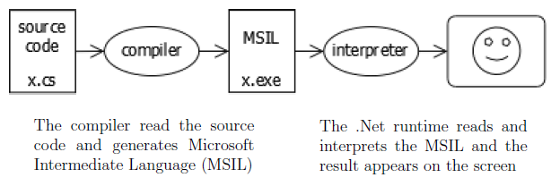
Interpreting vs. Compiling
There are two ways to translate a program; interpreting and compiling.
An interpreter is a program that reads and translate a high-level program line-by-line
A compiler is a program that reads a program and translates it all at once, then user runs the compiled code later
C# is both compiled and interpreted

Slide 20
What is a program?
A program is a sequence of instructions that specifies how to perform a computation or other task
There are a few basic operations most languages perform:
input: Get data from the keyboard, or console, or some other device.
output: Display data on the screen or send data to a console or other device.
math: Perform basic mathematical operations like addition and multiplication.
testing: Check for certain conditions and run the appropriate sequence of statements.
repetition: Perform some action repeatedly, usually with some variation.

Slide 21
Debugging
Programming errors are called bugs and the process of tracking them down and correcting them is called debugging.
Syntax errors - Syntax refers to the structure of your program and the rules about that structure.
Run-time errors - so-called because the error does not appear until you run the program.
Logic errors and semantics - will compile and run without generating error messages, but it will not do the right thing.

Slide 22
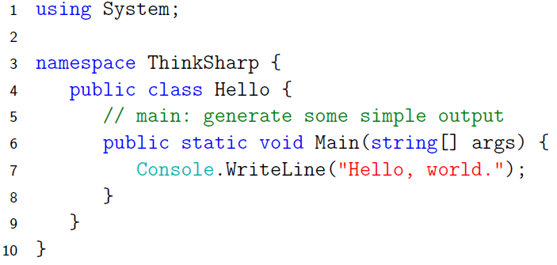
The First C# Program
Traditionally the first program people write in a new language is called "hello world" because all it does is display the words “Hello, World.”. In C#, this program looks like:

Slide 23
More about C#
C# is a modern object-oriented, general-purpose, high-level programming language
Created and developed by Microsoft together with the .NET platform that is used for developing office applications, web applications, websites, desktop applications, mobile applications, games and many others.
C# is one of the most popular programming languages
The C# language is distributed together with a special environment on which it is executed, called the Common Language Runtime (CLR) that makes C# programs portable
Unlike the Java language and platform that are open-source, C# and the .NET Framework are proprietary

Slide 24
“Hello, world” Program in Various Languages
; machine language example (only a portion of program)
; Hexidecimal or Binary
21 0a 00 00 00100001 00001010 00000000 00000000
0c 10 00 06 …
6f 72 6c 64 …
08 10 00 06 …
6f 2c 20 57 …
04 10 00 06 …
; Intel assemble example
mov ax,cs
mov ds,ax
mov ah,9
mov dx, offset Hello
int 21h
xor ax,ax
int 21h
Hello:
db "Hello World!",13,10,"$"
Low-level examples
/* C example */
#include <stdio.h>
main()
{
printf("Hello World!\n");
}
High-level examples
// C# example
using System;
namespace ThinkSharp {
public class Hello {
// main: generate some simple output
public static void Main(string[] args) {
Console.WriteLine("Hello, world.");
}
}
}
// Java example
class HelloWorld {
static public void main( String args[] ) {
System.out.println( "Hello World!" );
}
}
http://helloworldcollection.de/

Slide 25
C# vs. Competitors
C# is a modern programming language, widely spread, used by millions of programmers around the entire world. It is relatively simple and easy to learn (unlike C and C++), it is suitable for beginners while still widely used in the industry by many large companies.
Java is the most serious competitor to C#. Most people would agree.
C and C++ languages are considered complex and requires deep understanding of hardware. The C language can do low-level programming. C++ is good for program applications that require very close work with the hardware or that have special performance requirements (like 3D games).
Python is simple and very popular. C# shares a great deal of syntax with most other programming languages and will give them a good basis to learn other languages down the road.
Most Popular Programming Languages 1965 – 2019
https://www.youtube.com/watch?v=Og847HVwRSI
( In this ranking popularity is defined by percentage of programmers with either proficiency in specific language or currently learning/mastering one)

Slide 26
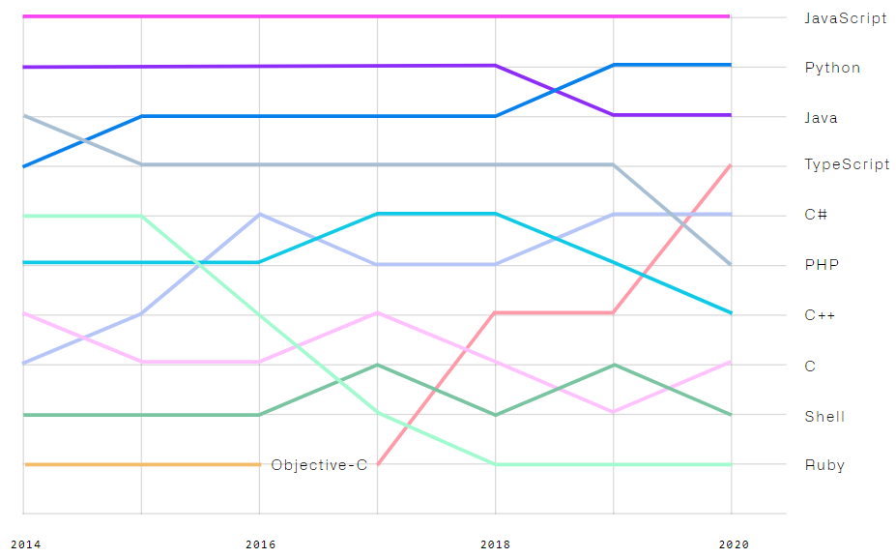
Top languages in recent years by Github
Rank
1
2
3
4
5
6
7
8
9
10
https://octoverse.github.com/

Slide 27
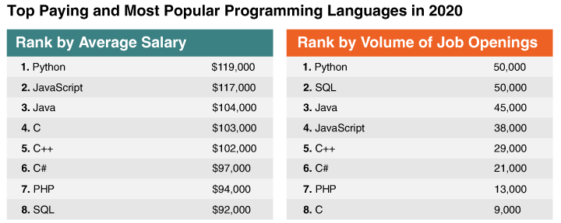
Ranking programming languages by pay and number of openings
https://www.codeplatoon.org/best-paying-most-in-demand-programming-languages-2020/

Slide 28
.NET, .NET Framework, and .NET Core
.NET is a developer platform made up of tools, programming languages, and libraries for building many different types of applications.
.NET Framework is the original implementation of .NET. It supports running websites, services, desktop apps, and more on Windows.
.NET Core is a cross-platform implementation for running websites, services, and console apps on Windows, Linux, and macOS. .NET Core is open source on GitHub.
Xamarin/Mono is a .NET implementation for running apps on all the major mobile operating systems, including iOS and Android.
Source: https://dotnet.microsoft.com/learn/dotnet/what-is-dotnet-framework

Slide 29
Architecture of .NET Framework
The two major components of .NET Framework are the Common Language Runtime and the .NET Framework Class Library.
The Common Language Runtime (CLR) is the execution engine that handles running applications. It provides services like thread management, garbage collection, type-safety, exception handling, and more.
The Class Library provides a set of APIs and types for common functionality. It provides types for strings, dates, numbers, etc. The Class Library includes APIs for reading and writing files, connecting to databases, drawing, and more.
Source: https://dotnet.microsoft.com/learn/dotnet/what-is-dotnet-framework

Slide 30
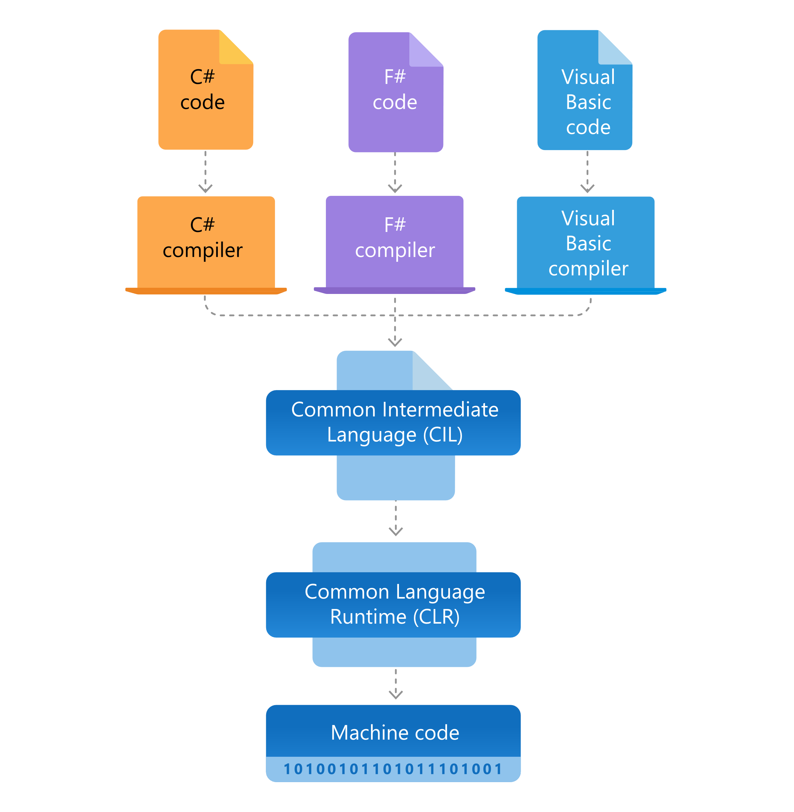
Architecture of .NET Framework
.NET applications are written in the C#, F#, or Visual Basic programming language. Code is compiled into a language-agnostic Common Intermediate Language (CIL). Compiled code is stored in assemblies—files with a .dll or .exe file extension.
When an app runs, the CLR takes the assembly and uses a just-in-time compiler (JIT) to turn it into machine code that can execute on the specific architecture of the computer it is running on.
Just-in-time compiler (JIT)
Source: https://dotnet.microsoft.com/learn/dotnet/what-is-dotnet-framework

Slide 31
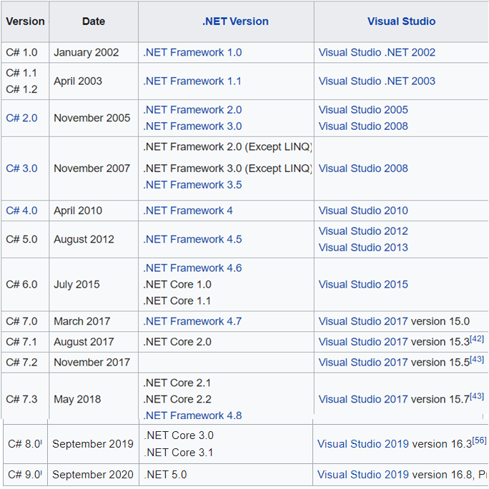
C#
Version
History
https://en.wikipedia.org/wiki/C_Sharp_(programming_language)

Slide 32
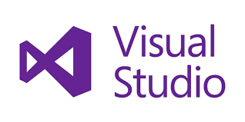
Visual Studio
Microsoft Visual Studio is an integrated development environment (IDE) from Microsoft.
It is used to develop computer programs, as well as websites, web apps, web services and mobile apps.
Visual Studio supports 36 different programming languages (of course, it supports C#)
The most basic edition of Visual Studio, the Community edition, is available free of charge. The currently supported Visual Studio version is 2019.

Slide 33
Visual Studio
To program in C#, we use Microsoft Visual Studio to write C# code and run it
A variety of versions of Visual Studio exists, we choose the free Community Edition (2019)
URL for download: https://visualstudio.microsoft.com/downloads/
you will want to check the box for .NET desktop development on the Workloads tab
Visual Studio 2019 for Mac is also available in case you use an Apple computer

Slide 34
Steps to Install Visual Studio
Step 1 - Make sure your computer is ready for Visual Studio
Check system requirements, apply the latest Windows updates etc.
Step 2 - Download Visual Studio at
https://visualstudio.microsoft.com/downloads/
Step 3 - Install the Visual Studio installer
run vs_community.exe for Visual Studio Community
Step 4 - Choose workloads
Choose .NET desktop development
Other Optional Steps - Choose individual components, Select the installation location, etc.
Now you are ready to try C# programming!

Slide 35
Create a simple C# console app in Visual Studio
Open Visual Studio 2019.
On the start window, choose Create a new project.
On the Create a new project window, enter or type console in the search box. Next, choose C# from the Language list, and then choose Windows from the Platform list. After you apply the language and platform filters, choose the Console App (.NET Core) template
In the Configure your new project window, type or enter HelloWorld in the Project name box. Then, choose Create.
Visual Studio opens your new project, and you're ready to code!
https://docs.microsoft.com/en-us/visualstudio/get-started/csharp/tutorial-console?view=vs-2019

Slide 36
Let’s install Visual Studio 2019
& run our first C# program!

Slide 37
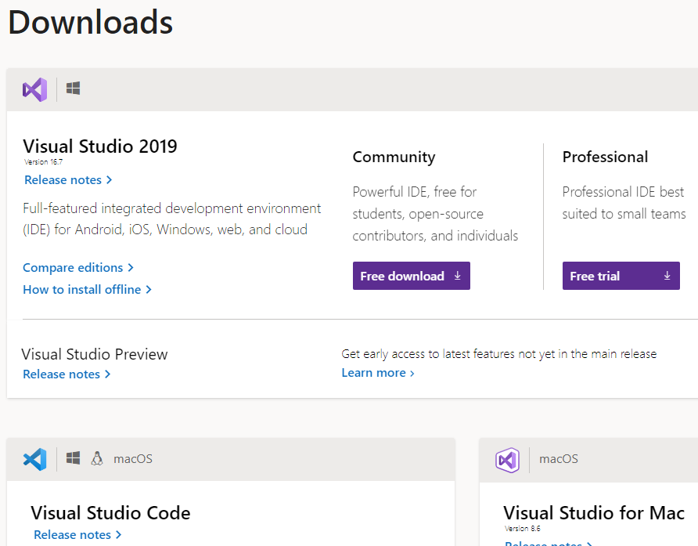

Slide 38
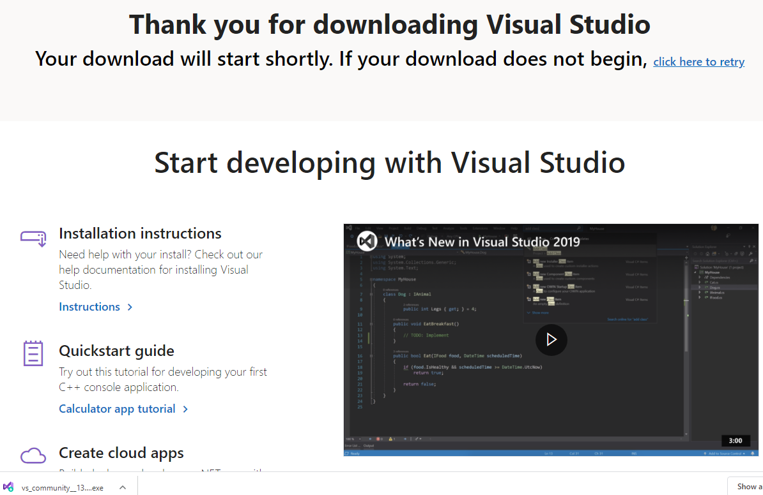

Slide 39
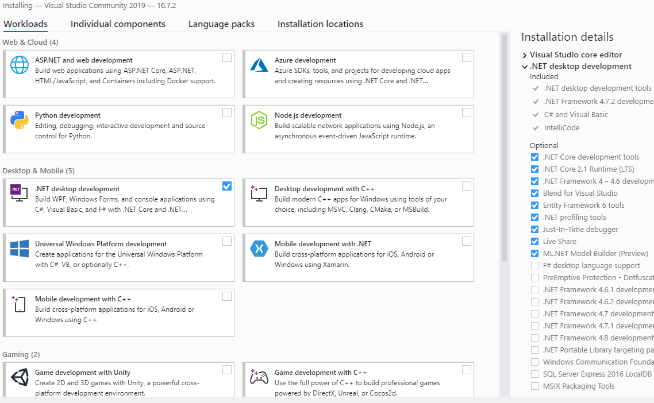

Slide 40
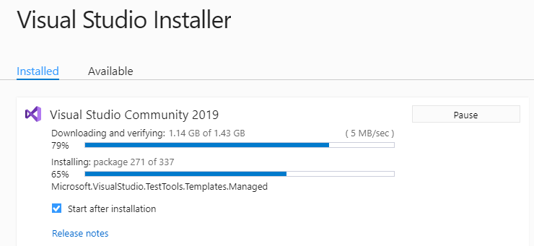
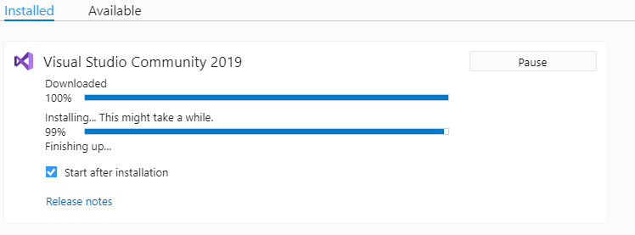
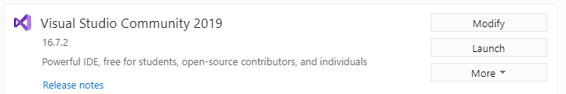

Slide 41
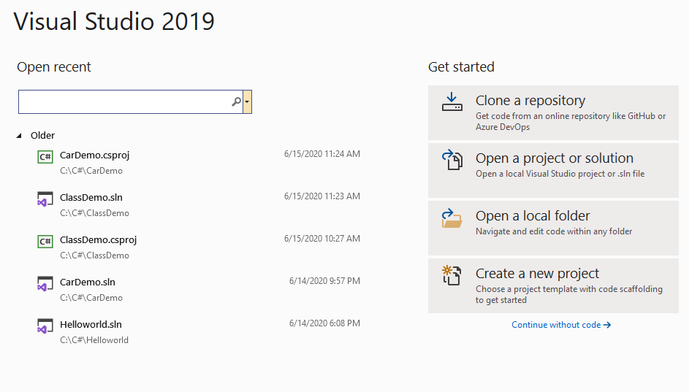

Slide 42
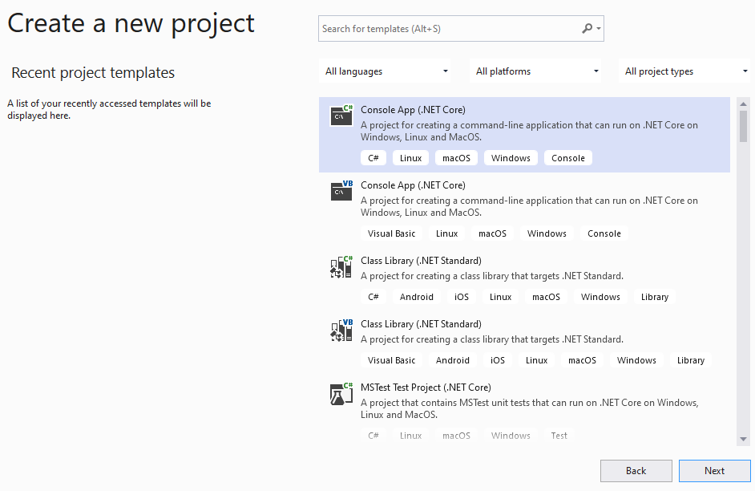

Slide 43
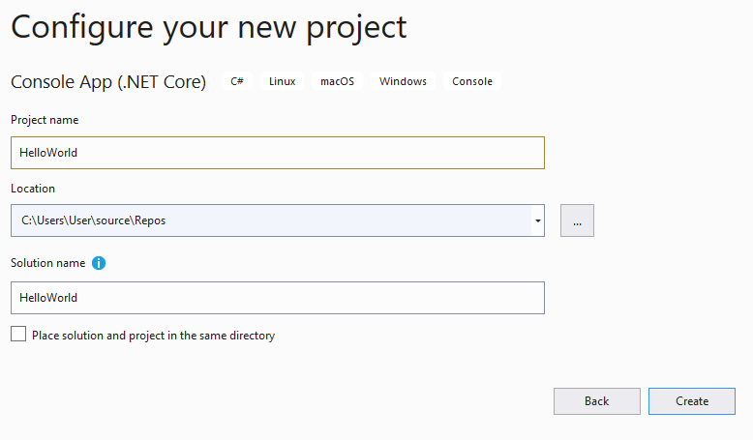

Slide 44
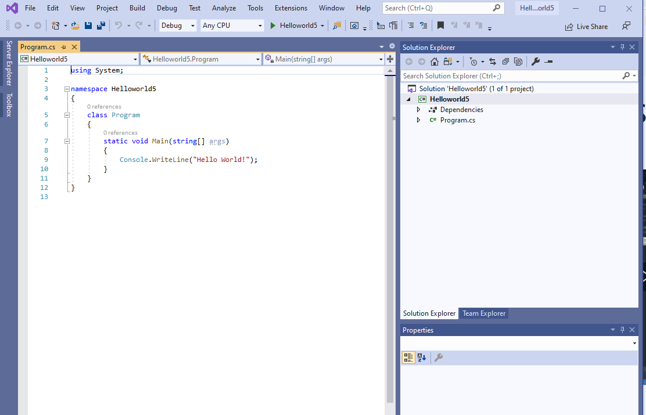
By default, a simple C# program is created!

Slide 45
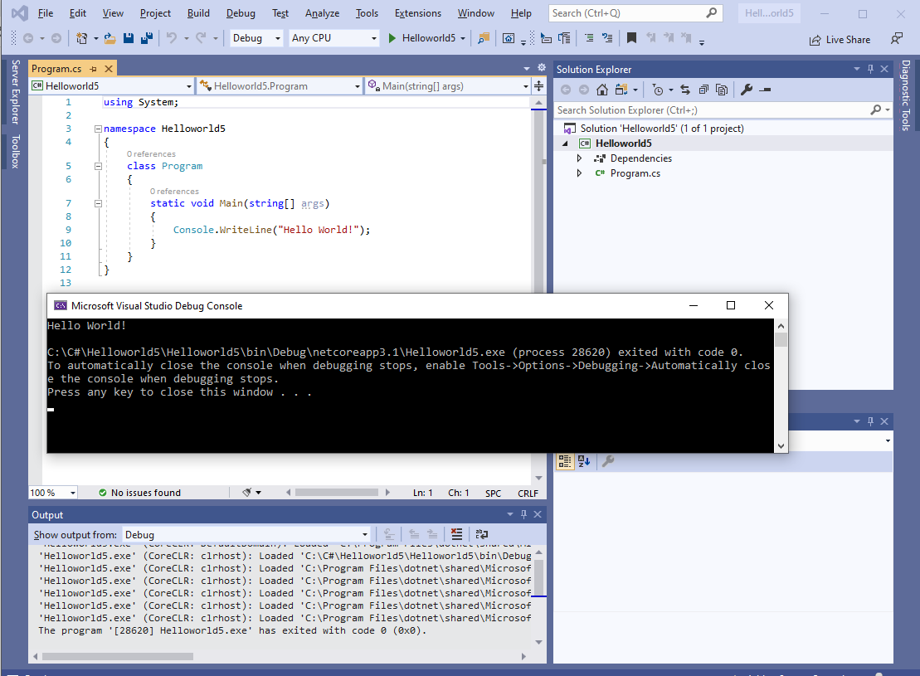

Slide 46
Reading Exercise
Review the course syllabus and provide me feedback if possible
Read textbook:
Preface
Chapter 1 - The way of the program
Chapter 2 - Variables and types
Read Foreword for “C Sharp Programming, Wikibooks.org” at:
https://en.wikibooks.org/wiki/C_Sharp_Programming/Foreword
Read remaining lecture slides (week01) in advance.

Slide 47
Practice Exercises
Install Visual Studio 2019 on your own computer
Video watching:
C# 101 series:
What is C#?
https://channel9.msdn.com/Series/CSharp-101/What-is-C
Hello World
https://channel9.msdn.com/Series/CSharp-101/CSharp-Hello-World
"Getting Started with Visual Studio 2019"
https://www.youtube.com/watch?v=1CgsMtUmVgs&t=50s
Run the first "Hello world" C# console program

Slide 48
Chapter 2 - Variables and Types

Slide 49
Let’s revisit the first C# program
Line 1: “using System” means we can use classes from System
Line 2: A blank line for good readability. C# ignores white spaces
Line 3: Define a namespace (container of classes, etc.)
Line 4: Define a class called Hello. Note that class is a container of methods and data
Line 5: single-line comment, C# ignores it
Line 6: Main method always appears in a C# program
Line 7: Console is a class of the System namespace, and it has a WriteLine method
Line 1 & 7 are C# statements that end with a semicolon ;

Slide 50
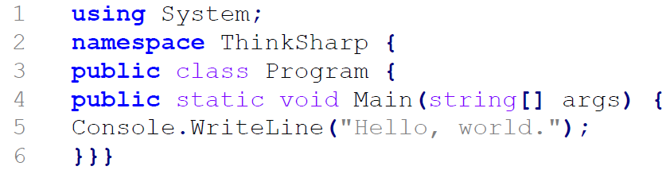
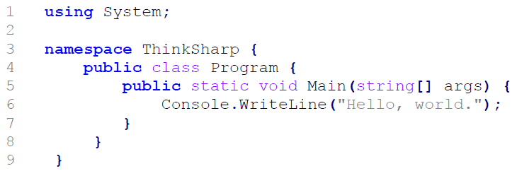
Indentation
(1)
(2)
Are these three programs the same?
(3)

Slide 51
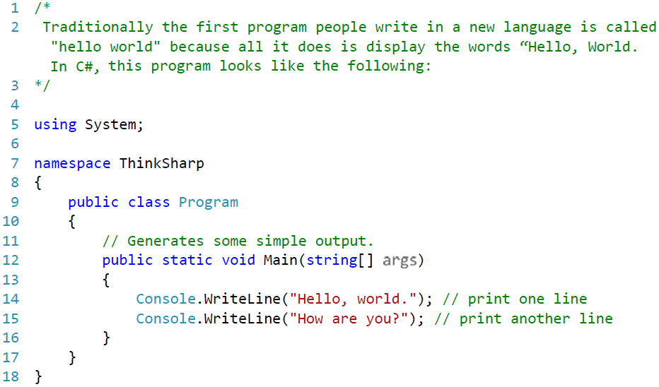
C# Program with Comments
C# compiler will ignore all the text in green because they are comments!

Slide 52
Comments in C#
Comments are used to explain C# code or to make it readable
C# ignores comments when compiling a program
Single line comments start with two forward slashes, //, until the end of the line
Block or multi-line comments: everything in between /* … */, and can be multiple lines
// is usually used for short comments and /* */ for longer comments

Slide 53
Variables
Values are things that can be written, stored and operated on, e.g.
"Hello world! ", 5, 8, 'c', 3.1415926
A variable is a named location that stores a value
To store a value, you need to create (declare) a variable
A variable must be declared before it is used. The variable declaration syntax is:
<data_type> <variable_list>;
Variables can be initialized in their declaration:
<data_type> <variable_name> = value;
Examples:
string firstName, lastName;
int i, j = 5;
char c = 'Y';

Slide 54
Data Types
A variable holds data of a specific type
A type must be provided when you declare a variable to store data
C# is a type-safe language, which means the compiler guarantees that the values stored in the variables are always of appropriate type. Some type examples:
Type Represents
-------------------------------------------------------------
bool Boolean value
byte 8-bit unsigned integer
char 16-bit Unicode character
decimal 128-bit precise decimal values with 28-29 significant digits
double 64-bit double-precision floating point type
float 32-bit single-precision floating point type
int 32-bit signed integer type
long 64-bit signed integer type
short 16-bit signed integer type

Slide 55
Now it’s about time to introduce binary number systems

Slide 56
The Decimal System
System based on decimal digits (0, 1, 2, 3, 4, 5, 6, 7, 8, 9) to represent numbers
For example, the number 83 means eight tens plus three:
83 = (8 * 10) + 3
The number 4728 means four thousands, seven hundreds, two tens, plus eight:
4728 = (4 * 1000) + (7 * 100) + (2 * 10) + 8
The decimal system is said to have a base, or radix, of 10. This means that each digit in the number is multiplied by 10 raised to a power corresponding to that digit’s position:
83 = (8 * 10¹) + (3 * 10⁰)
4728 = (4 * 10³) + (7 * 10²) + (2 * 10¹) + (8 * 10⁰)
Notes:
In everyday life we use a system based on decimal digits (0, 1, 2, 3, 4, 5, 6, 7, 8, 9) to
represent numbers, and refer to the system as the decimal system. Consider what
the number 83 means. It means eight tens plus three:
83 = (8 * 10) + 3
The number 4728 means four thousands, seven hundreds, two tens, plus eight:
4728 = (4 * 1000) + (7 * 100) + (2 * 10) + 8
The decimal system is said to have a base, or radix, of 10. This means that each digit
in the number is multiplied by 10 raised to a power corresponding to that digit’s
position:
83 = (8 * 10¹) + (3 * 10⁰)
4728 = (4 * 10³) + (7 * 10²) + (2 * 10¹) + (8 * 10⁰)

Slide 57
Decimal Fractions
The same principle holds for decimal fractions, but negative powers of 10 are used. Thus, the decimal fraction 0.256 stands for 2 tenths plus 5 hundredths plus 6 thousandths:
0.256 = (2 * 10⁻¹) + (5 * 10⁻²) + (6 * 10⁻³)
A number with both an integer and fractional part has digits raised to both positive and negative powers of 10:
442.256 = (4 * 10²) + (4 + 10¹) + (2 * 10⁰) + (2 * 10⁻¹) + (5 * 10⁻²)
+ (6 * 10⁻³)
Most significant digit
The leftmost digit (carries the highest value)
Least significant digit
The rightmost digit
Notes:
The same principle holds for decimal fractions, but negative powers of 10 are
used. Thus, the decimal fraction 0.256 stands for 2 tenths plus 5 hundredths plus
6 thousandths:
0.256 = (2 * 10⁻¹) + (5 * 10-²) + (6 * 10-³)
A number with both an integer and fractional part has digits raised to both
positive and negative powers of 10:
442.256 = (4 * 10²) + (4 + 10¹) + (2 * 10⁰) + (2 * 10⁻¹) + (5 * 10⁻²)
+ (6 * 10⁻³)
In any number, the leftmost digit is referred to as the most significant digit,
because it carries the highest value. The rightmost digit is called the least significant
digit. In the preceding decimal number, the 4 on the left is the most significant digit
and the 6 on the right is the least significant digit.

Slide 58
The Binary System
Only two digits, 1 and 0
Represented to the base 2
The digits 1 and 0 in binary notation have the same meaning as in decimal notation:
0₂ = 0₁₀
1₂ = 1₁₀
To represent larger numbers each digit in a binary number has a value depending on its position:
10₂ = (1 * 2¹) + (0 * 2⁰) = 2₁₀
11₂ = (1 * 2¹) + (1 * 2⁰) = 3₁₀
100₂ = (1 * 2²) + (0 * 2¹) + (0 * 2⁰) = 4₁₀
and so on. Again, fractional values are represented with negative powers of the radix:
1001.101 = 2³ + 2⁰ + 2⁻¹ + 2⁻³ = 9.625₁₀
Notes:
In the decimal system, 10 different digits are used to represent numbers with a base
of 10. In the binary system, we have only two digits, 1 and 0. Thus, numbers in the
binary system are represented to the base 2.
To avoid confusion, we will sometimes put a subscript on a number to indicate
its base. For example, 83₁₀ and 4728₁₀ are numbers represented in decimal notation
or, more briefly, decimal numbers. The digits 1 and 0 in binary notation have the
same meaning as in decimal notation:
0₂ = 0₁₀
1₂ = 1₁₀
To represent larger numbers, as with decimal notation, each digit in a binary number
has a value depending on its position:
10₂ = (1 * 2¹) + (0 * 2⁰) = 2₁₀
11₂ = (1 * 2¹) + (1 * 2⁰) = 3₁₀
100₂ = (1 * 2²) + (0 * 2¹) + (0 * 2⁰) = 4₁₀
and so on. Again, fractional values are represented with negative powers of the
radix:
1001.101 = 2³ + 2⁰ + 2⁻¹ + 2⁻³ = 9.625₁₀

Slide 59
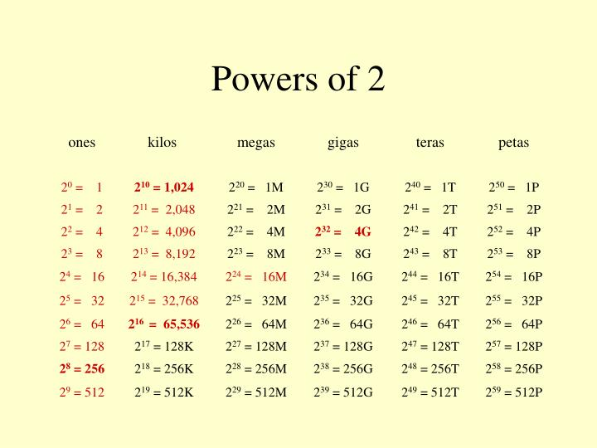
Notes:
In the decimal system, 10 different digits are used to represent numbers with a base
of 10. In the binary system, we have only two digits, 1 and 0. Thus, numbers in the
binary system are represented to the base 2.
To avoid confusion, we will sometimes put a subscript on a number to indicate
its base. For example, 83₁₀ and 4728₁₀ are numbers represented in decimal notation
or, more briefly, decimal numbers. The digits 1 and 0 in binary notation have the
same meaning as in decimal notation:
0₂ = 0₁₀
1₂ = 1₁₀
To represent larger numbers, as with decimal notation, each digit in a binary number
has a value depending on its position:
10₂ = (1 * 2¹) + (0 * 2⁰) = 2₁₀
11₂ = (1 * 2¹) + (1 * 2⁰) = 3₁₀
100₂ = (1 * 2²) + (0 * 2¹) + (0 * 2⁰) = 4₁₀
and so on. Again, fractional values are represented with negative powers of the
radix:
1001.101 = 2³ + 2⁰ + 2⁻¹ + 2⁻³ = 9.625₁₀

Slide 60
Hexadecimal Notation
Binary digits are grouped into sets of four bits, called a nibble
Each possible combination of four binary digits is given a symbol, as follows:
0000 = 0 0100 = 4 1000 = 8 1100 = C
0001 = 1 0101 = 5 1001 = 9 1101 = D
0010 = 2 0110 = 6 1010 = A 1110 = E
0011 = 3 0111 = 7 1011 = B 1111 = F
Because 16 symbols are used, the notation is called hexadecimal and the 16 symbols are the hexadecimal digits, thus:
2C₁₆ = (2₁₆ * 16¹) + (C₁₆ * 16 ⁰)
= (2₁₀ * 16¹) + (12₁₀ * 16⁰) = 44
Notes:
Because of the inherent binary nature of digital computer components, all forms of
data within computers are represented by various binary codes. However, no matter
how convenient the binary system is for computers, it is exceedingly cumbersome
for human beings. Consequently, most computer professionals who must spend time
working with the actual raw data in the computer prefer a more compact notation.
What notation to use? One possibility is the decimal notation. This is certainly
more compact than binary notation, but it is awkward because of the tediousness of
converting between base 2 and base 10.
Instead, a notation known as hexadecimal has been adopted. Binary digits are
grouped into sets of four bits, called a nibble. Each possible combination of four
binary digits is given a symbol.
Because 16 symbols are used, the notation is called hexadecimal, and the 16 symbols
are the hexadecimal digits.

Slide 61
Decimal, Binary, and Hexadecimal
Decimal (base 10) | Binary (base 2) | Hexadecimal (base 16)
0 | 0000 | 0
1 | 0001 | 1
2 | 0010 | 2
3 | 0011 | 3
4 | 0100 | 4
5 | 0101 | 5
6 | 0110 | 6
7 | 0111 | 7
8 | 1000 | 8
9 | 1001 | 9
10 | 1010 | A
11 | 1011 | B
12 | 1100 | C
13 | 1101 | D
14 | 1110 | E
15 | 1111 | F
16 | 0001 0000 | 10
17 | 0001 0001 | 11
18 | 0001 0010 | 12
31 | 0001 1111 | 1F
100 | 0110 0100 | 64
255 | 1111 1111 | FF
256 | 0001 0000 0000 | 100
Notes:
A sequence of hexadecimal digits can be thought of as representing an integer
in base 16 (Table 10.3).

Slide 62
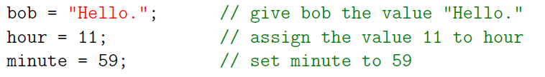
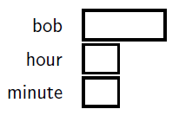
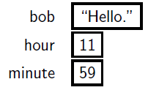
Assignment Statement
After we created variables, we can store values to the variables with an assignment statement:
after assignment:
As a general rule, a variable has to have the same type as the value you assign it.

Slide 63
Identifiers
An identifier is the name you assign to a type (class, struct, etc.), member, variable, or namespace
So identifiers are the user-defined name of the program components
Valid identifiers must follow some rules, and some examples:
The only allowed characters for identifiers are all alphanumeric characters([A-Z], [a-z], [0-9]), '_' (underscore)
Identifiers must start with a letter, or
in other word: Identifiers should not start with digits([0-9])
Identifiers should not contain white spaces
C# identifiers are case-sensitive

Slide 64
Keywords
abstract as base bool
break byte case catch
char checked class const
continue decimal default delegate
do double else enum
event explicit extern false
finally fixed float for
foreach goto if implicit
in int interface internal
is lock long namespace
new null object operator
out override params private
protected public readonly ref
return sbyte sealed short
sizeof stackalloc static string
struct switch this throw
true try typeof uint
ulong unchecked unsafe ushort
using virtual void volatile
while
Keywords are predefined, reserved identifiers that have special meanings to the compiler
They cannot be used as identifiers in your program unless they include @ as a prefix
The table on the right lists keywords that are reserved identifiers in a C# program
https://docs.microsoft.com/en-us/dotnet/csharp/language-reference/keywords/

Slide 65
Exercise
Variable Valid or Invalid Why?
dayOfWeek
3dGraph
june2020
_case
case
@case
my name
C#

Slide 66
Exercise
Variable Valid or Invalid Why?
dayOfWeek
3dGraph
june2020
_case
case
@case
my name
C#
https://docs.microsoft.com/en-us/dotnet/csharp/programming-guide/inside-a-program/identifier-names

Slide 67
Operators
An operator is a symbol that tells the compiler to perform specific mathematical or logical manipulations. C# has rich set of built-in operators and provides the following type of operators:
Arithmetic Operators Bitwise Operators
Relational Operators Assignment Operators
Logical Operators Other Operators
Operators are symbols used to represent computations like addition (+) and multiplication (*)
Most operators do what you expect them to do because they are common mathematical symbols like addition (+) and multiplication (*)
Expressions can contain both variable names and numbers. Variables are replaced with their values before the computation is performed

Slide 68
Operator Precedence
In an expression with multiple operators, the operators with higher precedence are evaluated before the operators with lower precedence:
int x = 2 + 3 * 4; Console.WriteLine(x);
Use parentheses to change the order of evaluation imposed by operator precedence:
int x = (2 + 3) * 4; Console.WriteLine(x);
Precedence | Operators | Cardinality | Associativity
High | () [] . new typeof | Unary | Left to right
 | ! ~ + – ++ — (cast) | Unary | Left to right
 | * / % | Binary | Left to right
 | + – | Binary | Left to right
 | < <= > >= is as | Binary | Left to right
 | == != | Binary | Left to right
 | & | Binary | Left to right
 | ^ | Binary | Left to right
 | | | Binary | Left to right
 | && | Binary | Left to right
low | || | Binary | Left to right

Slide 69
Homework Assignment
(See Moodle for details)

